Slide 1


Slide 2
배경색
199,199,199 x버튼
#C7C7C7;
255,255,255
Title
#FFFFFF
250,250,250
Main, input(search),
Feed user profile
#FAFAFA
219,219,219
User-image
#DBDBDB
197,45,144 #C52D90
249,154,71 #F99A47
테두리색
219,219,219
모든테두리
#DBDBDB
237,237,237
댓글구분선
#EDEDED
38,38,38
아이콘
#262626
글씨색
142,142,142
Follower name,
“더보기”, 프로필
#8E8E8E
38,38,38
Feed user name,
Feed 내용
#262626
00,149,246
“팔로우”
#0095F6
177,222,252
“게시”
#B1DEFC
237,73,86
피드 옵션 모달
#ED4956

Slide 3
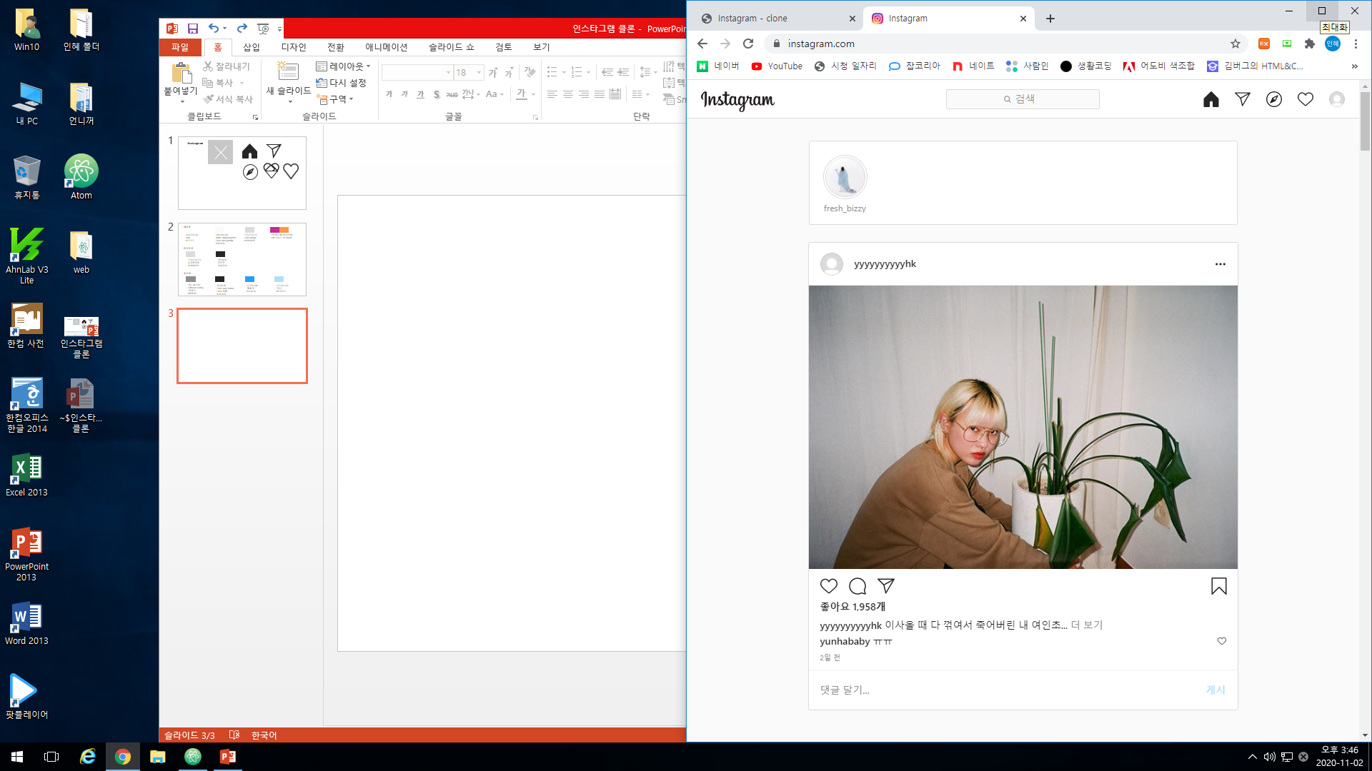
614 * 118
Display: flex;
Padding: 16px 18px;
Margin-bottom:24px;
border:1px solid #DBDBDB;
border-radius: 3px;
background-color: #FFFFFF;
Img
56*56
Margin-right:18px;
.User-Image
62*62
padding:2px;
margin: 0 auto 4px auto;
border:1px solid #DBDBDB;
border-radius: 50%;
background-color: #FFFFFF;
.User-card
Margin-right: 18px;
.User-id
Font-size:12px;

Slide 4
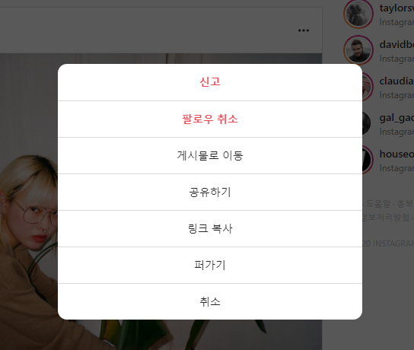
Feed option modal
400*48*7
border-radius: 14px;
background-color: #FFFFFF;
font
Font-weight: 700/400;
Color:#262626/#ED4956
Line-height:1.5;
border
border:1px solid #DBDBDB;

Slide 5
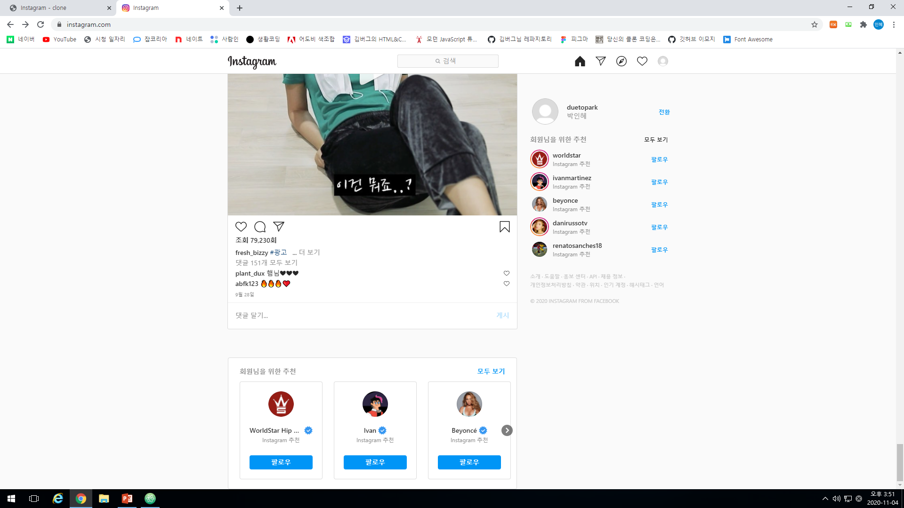
Recommend for you
614*280
border-radius: 4px;
background-color: #FFFFFF;
Padding:20px 24px;
Font
Margin-bottom: px;
Font-weight: 600;
Font-size: 14px
Color:#8E8E8E/#21A2F6
Line-height:1.285714285714286

Slide 6
Recommend-User-card
174*206
Padding:20px;
border-radius: 4px;
background-color: #FFFFFF;
border
border:1px solid #DBDBDB;
font
Font-weight: 600;
Color:#262626
Margin-right:4px;
Margin-bottom:4px;
img
54*54
Margin-bottom:20px;
span
18*18
::after
Font-size:12px;
Font-weight:400px;
Line-height: 1.166666666666667
Margin-bottom:28px;

Slide 7
134*30
border-radius: 4px;
background-color: #21A2F6;
#0095f6;
Color:#fff;
font
Font-size:14px;
Font-weight:600;

Slide 8
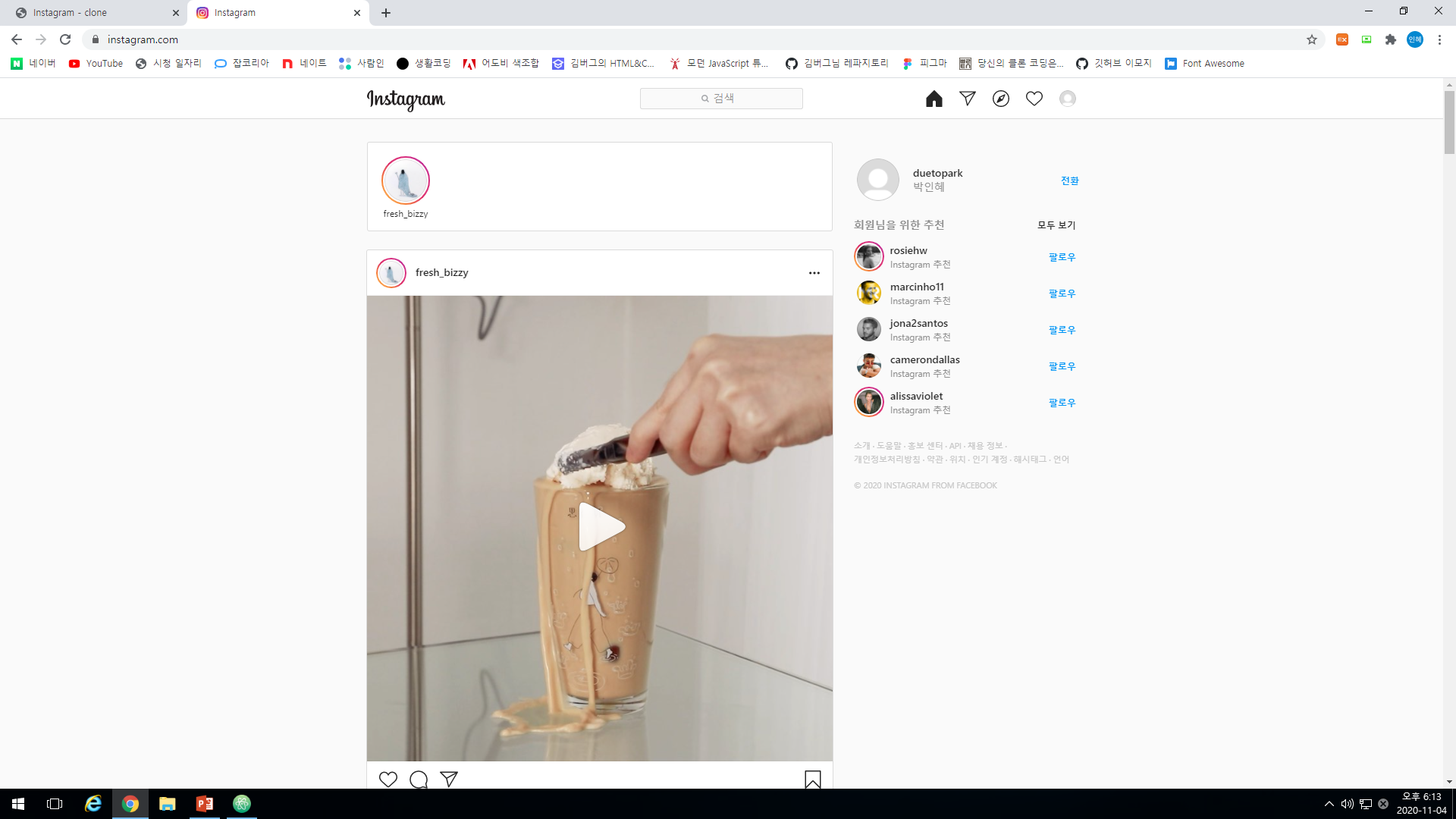
Aside
My profile
293*56
Font-size:14px;
Font-weight:600;
Margin-bottom:10px;
img
56*56
Margin-right:20px;
strong
Color:#8E8E8E;
h1
Margin-bottom:4px;
Font-size:14px;
Font-weight:600;
Color:#262626;
Button
Margin-right:20px;
Font-weight:600;
Font-size: 12px;
Line-height:1.666666667
Color:#0095F6;

Slide 9
293*293
Color:#8E8E8E;
H2
Margin-bottom:16px;
Font-size:14px;/18
Font-weight:600;
Color:#8E8E8E;
A
Font:12px;/14
Color:#262626;
img
32*32
Margin-right:12px;
strong
Margin-bottom;8px;
Font-weight:600;
Font-size: 14px;
Color:#262626;
button
Position : absolute;
Right:-16px;
Top50%;
Transform: translate(-50%);
Strong::after
Content:’Instagram 추천’;
Font-weight:400;
Font-size: 12px;
Color:#8E8E8E;

